Slide 1
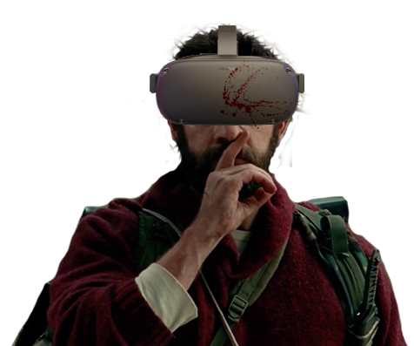
Proof of Concept Level: The Barn

Slide 2
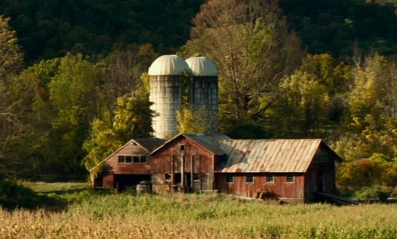
Overview
Panoramic 360 camera, can navigate freely within the space.
Replicate the interior of the barn living area from the film.
Recently abandoned after a fight with the monsters, so there should be signs of struggle.
No interior lighting, gloomily lit by exterior light coming in through windows and open doors (moonlight?).
Notes:
<number>

Slide 3
Plan View: Ground Level
Ladder
Windows
Stall
2
5
7
8
Junction Box
Mattress
1
Food Prep Bench
Doors
Drapes
4
Dining Table
Stairs to flooded safe room
3
9
6
Cupboard
Trough converted to washbasins
Refrigerator
Straw Bales covered with blankets and duvets
NB: This is my rough estimate from watching the film, so nothing’s to scale.
Notes:
<number>

Slide 4
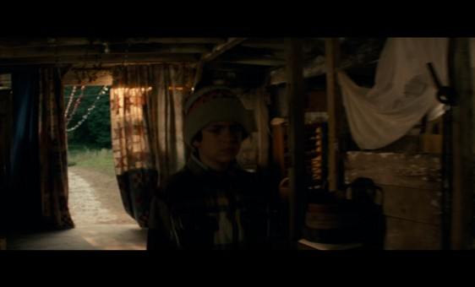
Area 1: Entrance
Additional visual ref for all these areas is available in “The Barn” folder.
Sliding barn doors open on the exterior.
Drapes hang over the opening.
Salt trail leads up to the entrance.
Fairy Lights come in under the lintel.
Notes:
<number>

Slide 5
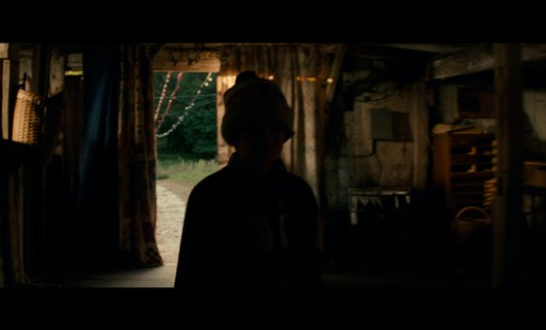
Area 2: Storage and Stall
Camera doesn’t really go into this area in the film so some assumptions have been made.
Chest of drawers with drawers missing, basket, other clutter.
Jacket hung on back wall.
Stall with cloth drapes, assuming ladder to hay loft is in the stall, though it isn’t visible in any shots.
Notes:
<number>

Slide 6
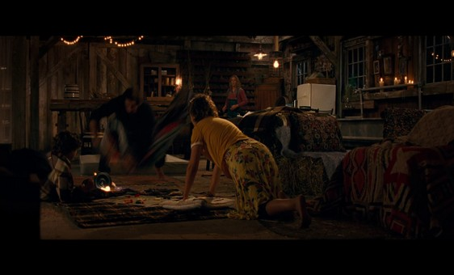
Area 3: Vestibule
Wicker basket hanging from prop (visible on the left hand side of previous image).
Straw bales with throws and duvets over them (shown here on the right of frame).
Notes:
<number>

Slide 7
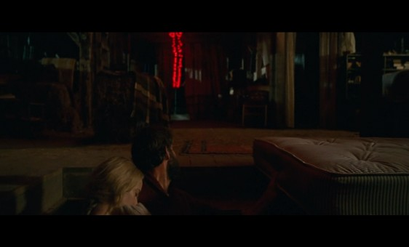
Area 4: Safe Room Entrance
Most shots of this are from within the safe room looking out.
Mattress partially covers entrance.
Stairs lead down, but the area is flooded, water laps at the top step.
Notes:
<number>

Slide 8
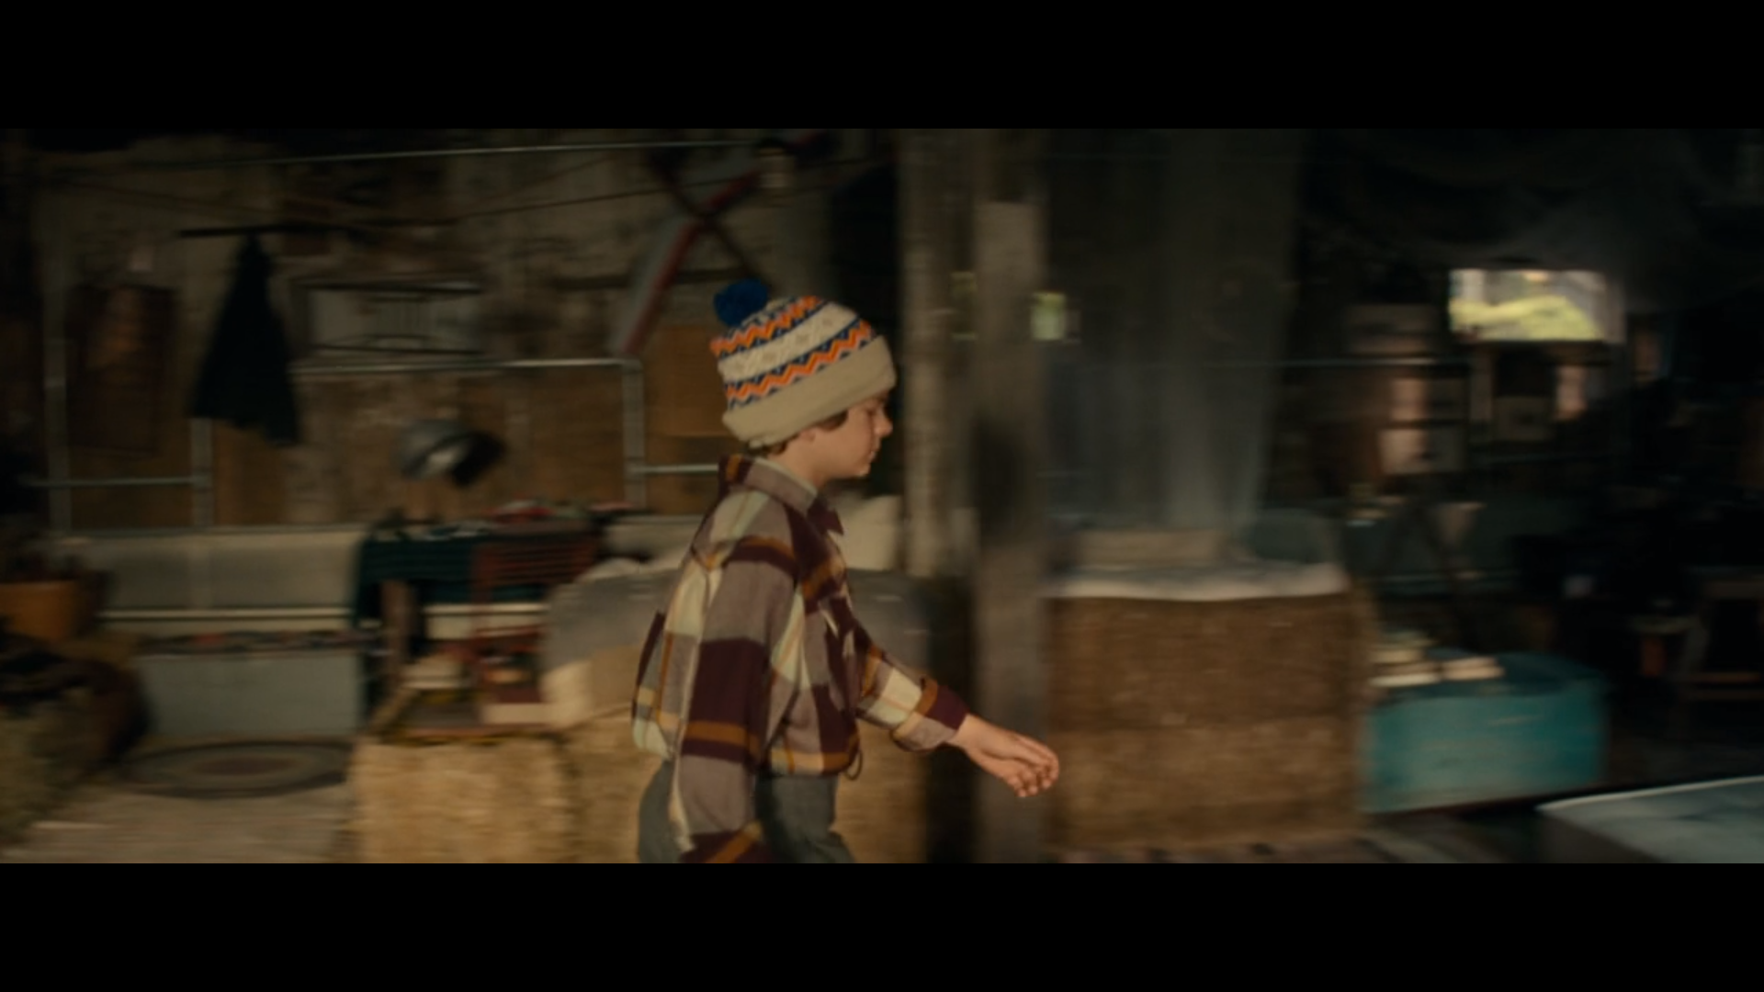
Area 5: Seating Area
It is the area on the left half of this shot.
Comprises straw bale seating, a rug, some shelves and a colander hanging from the wall.
Notes:
<number>

Slide 9
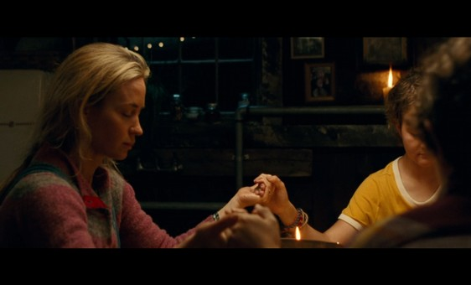
Area 6: Mantle and Pipes
Water pipes are exposed on the wall here, leading to the trough/wash basins (which are in area 9).
A wooden mantelpiece has melted candles and an electric light is fixed to the wall.
There are framed pictures above the mantelpiece.
Notes:
<number>

Slide 10
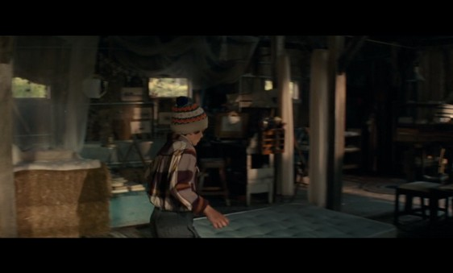
Area 7: Art Station
Stool in front of a small table, on which an easel stands, with a drawing of a fish.
Pictures tacked to boards against the wall.
Small table with piles of books.
Notes:
<number>

Slide 11
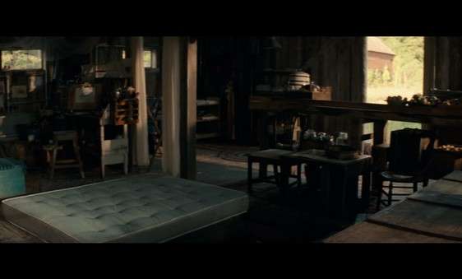
Area 8: Shelves
This area is difficult to see as Area 7 and the pillar are always in the way in shots.
There is a clothes horse with garments drying on it, a ceiling fan, and some shelves featuring storage jars and boxes.
Notes:
<number>

Slide 12
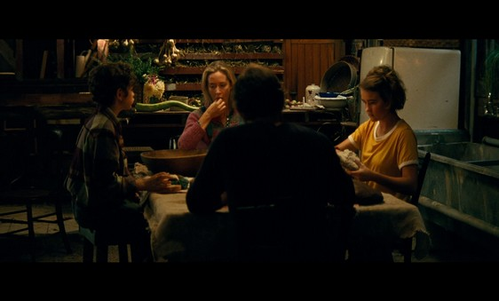
Area 9: Kitchen Area
This is one of the best referenced and most complex areas.
Features a food prep bench, which has a rack with jars under the top.
Shelves of rotting ingredients line the back wall. Also a cupboard and a pile of pots and utensils.
Refrigerator and wash basin, and steamer pit next to bench.
Dining table in front.
Notes:
<number>

Slide 13
Plan View: Hay Loft
Straw Bales covered with blankets and sheets
Dining Table
Guard Rail
NB: This is my rough estimate from watching the film, so nothing’s to scale.
Notes:
<number>

Slide 14
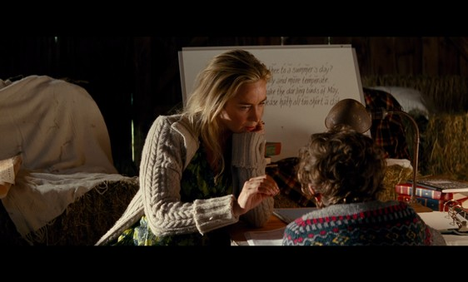
Hay Loft: Home School Area
Ref material on this area is somewhat lacking.
Upper balcony reached by a ladder in the stall (best guess).
Overlooks ground floor kitchen area.
Hay bales line the walls.
Features a whiteboard propped on bales, and a low table strewn with books and folders.
Notes:
<number>

Slide 15
Asset List
Main Interior Lower Level
Wooden Floor
Wooden Walls
Wooden Roof
Wooden Beams and Props
Windows
Fairy Lights (strung through centre of building and out doors at either end)
Rugs
Area 1
Entrance
Drapes
Barn Doors
Junction Box on wall next to doors
Area 2
Assorted Clutter
Chest of Drawers
Cabinet
Jacket hung up
Basket
Wooden Stall with Cloth Drapes
Hay Loft Ladder
Area 3
Wicker Basket hung on Prop
Straw Bales with Throws
Area 4
Stairs Down to Safe Room
Mattress over the Opening
Area 5
Straw Bale Seating with Throws
Rug
Shelves
Colander hanging from wall
Area 6
Mantelpiece under windows with Candles
Pipes leading into Trough Wash Basins
Electric Wall Light and Framed Pictures
Area 7
Table with Books
Drawing Table with Easel and Stool
Drawings on Boards below Window
Pillows
Area 8
Clothes Horse
More Bookshelves
Ceiling Light
Shelves with Containers
Area 9
Dining Table
Chairs
Refrigerator
Bench
Cupboard
Shelves of Rotting Vegetables
Kitchen Knife
Steamer Pit (in floor next to bench)
Hay Loft
Straw Bales
Whiteboard
Books and Files
Writing Desk
Desk Lamp
Ladder
Guard Rail overlooking ground floor
Notes:
<number>

